Slide 1
Welcome to the world of Cambrian Multimedia presentation.

Slide 2
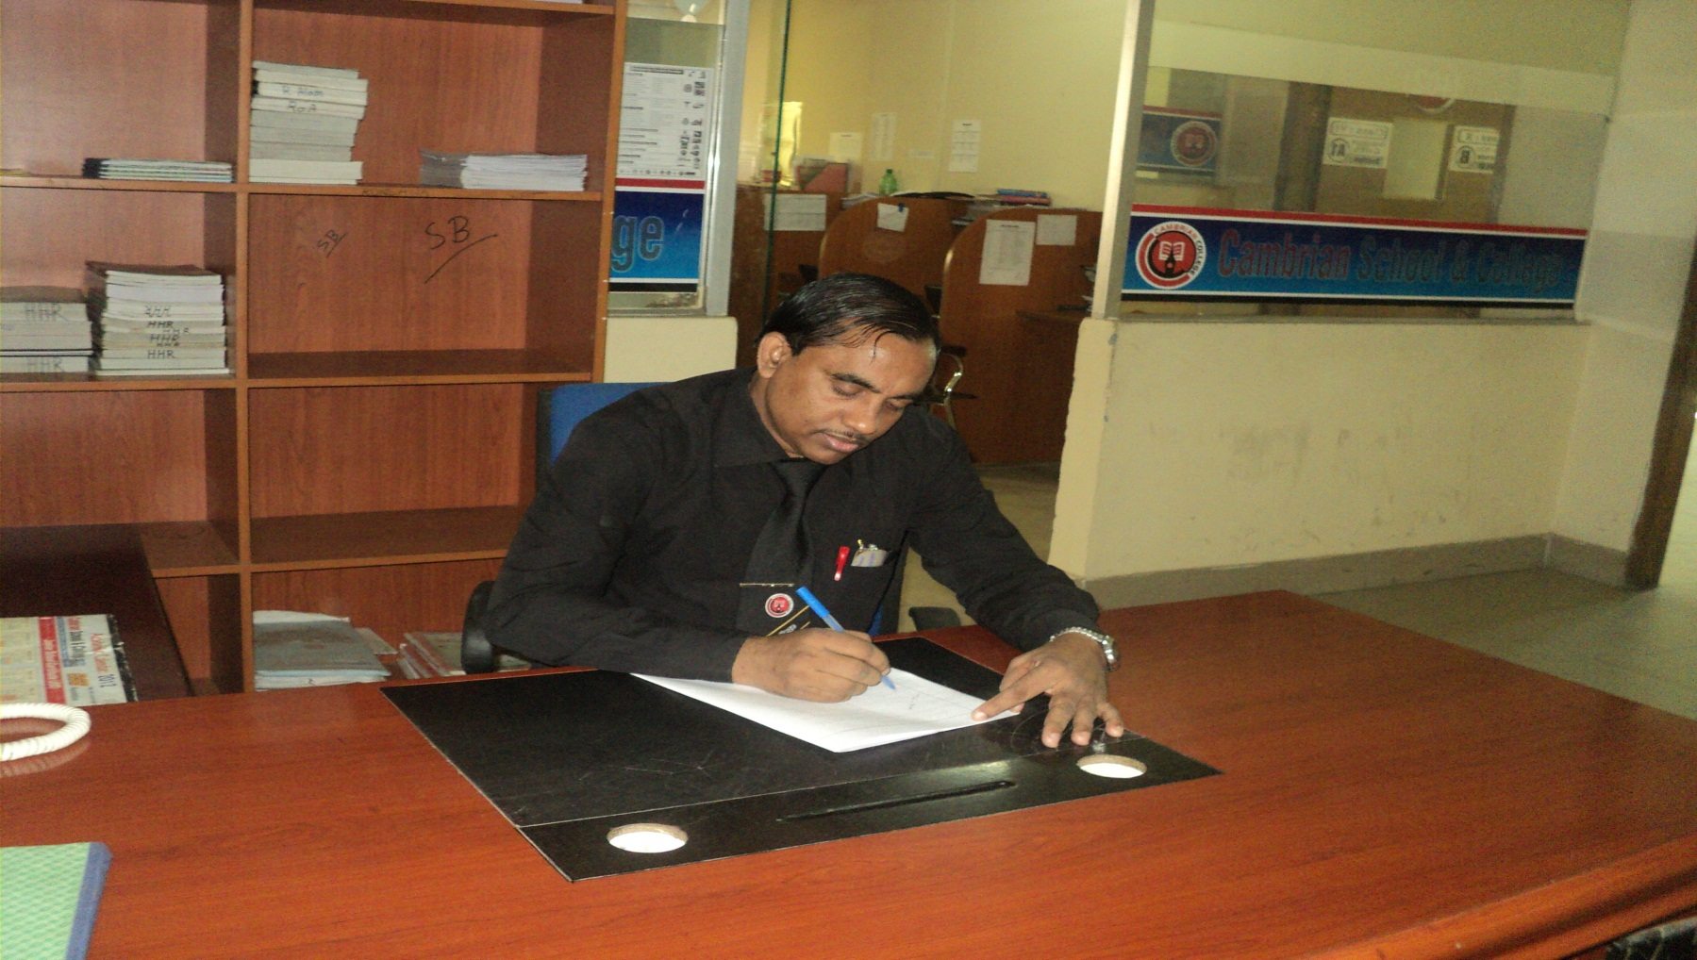
Md Hasan Hafizur Rahman
Senior Lecturer
Department of English
Cambrian School & College,Dhaka,
Class-Eight
English 1st Paper

Slide 3
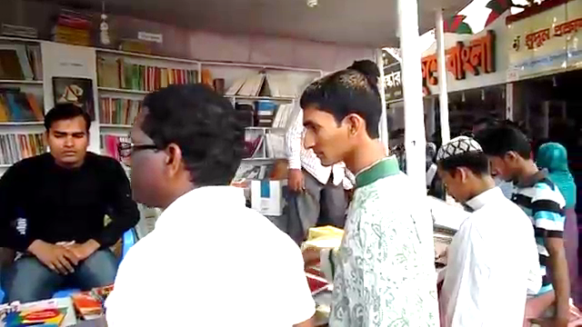
Visiting a Book Fair

Slide 4
Our Today’s Lesson is-
A dialogue on
“Visiting a book fair”

Slide 5
Learning outcomes
After we have studied this lesson we will be able to-
exchange greetings
ask and answer questions
achieve inspiration
write a dialogue.

Slide 6
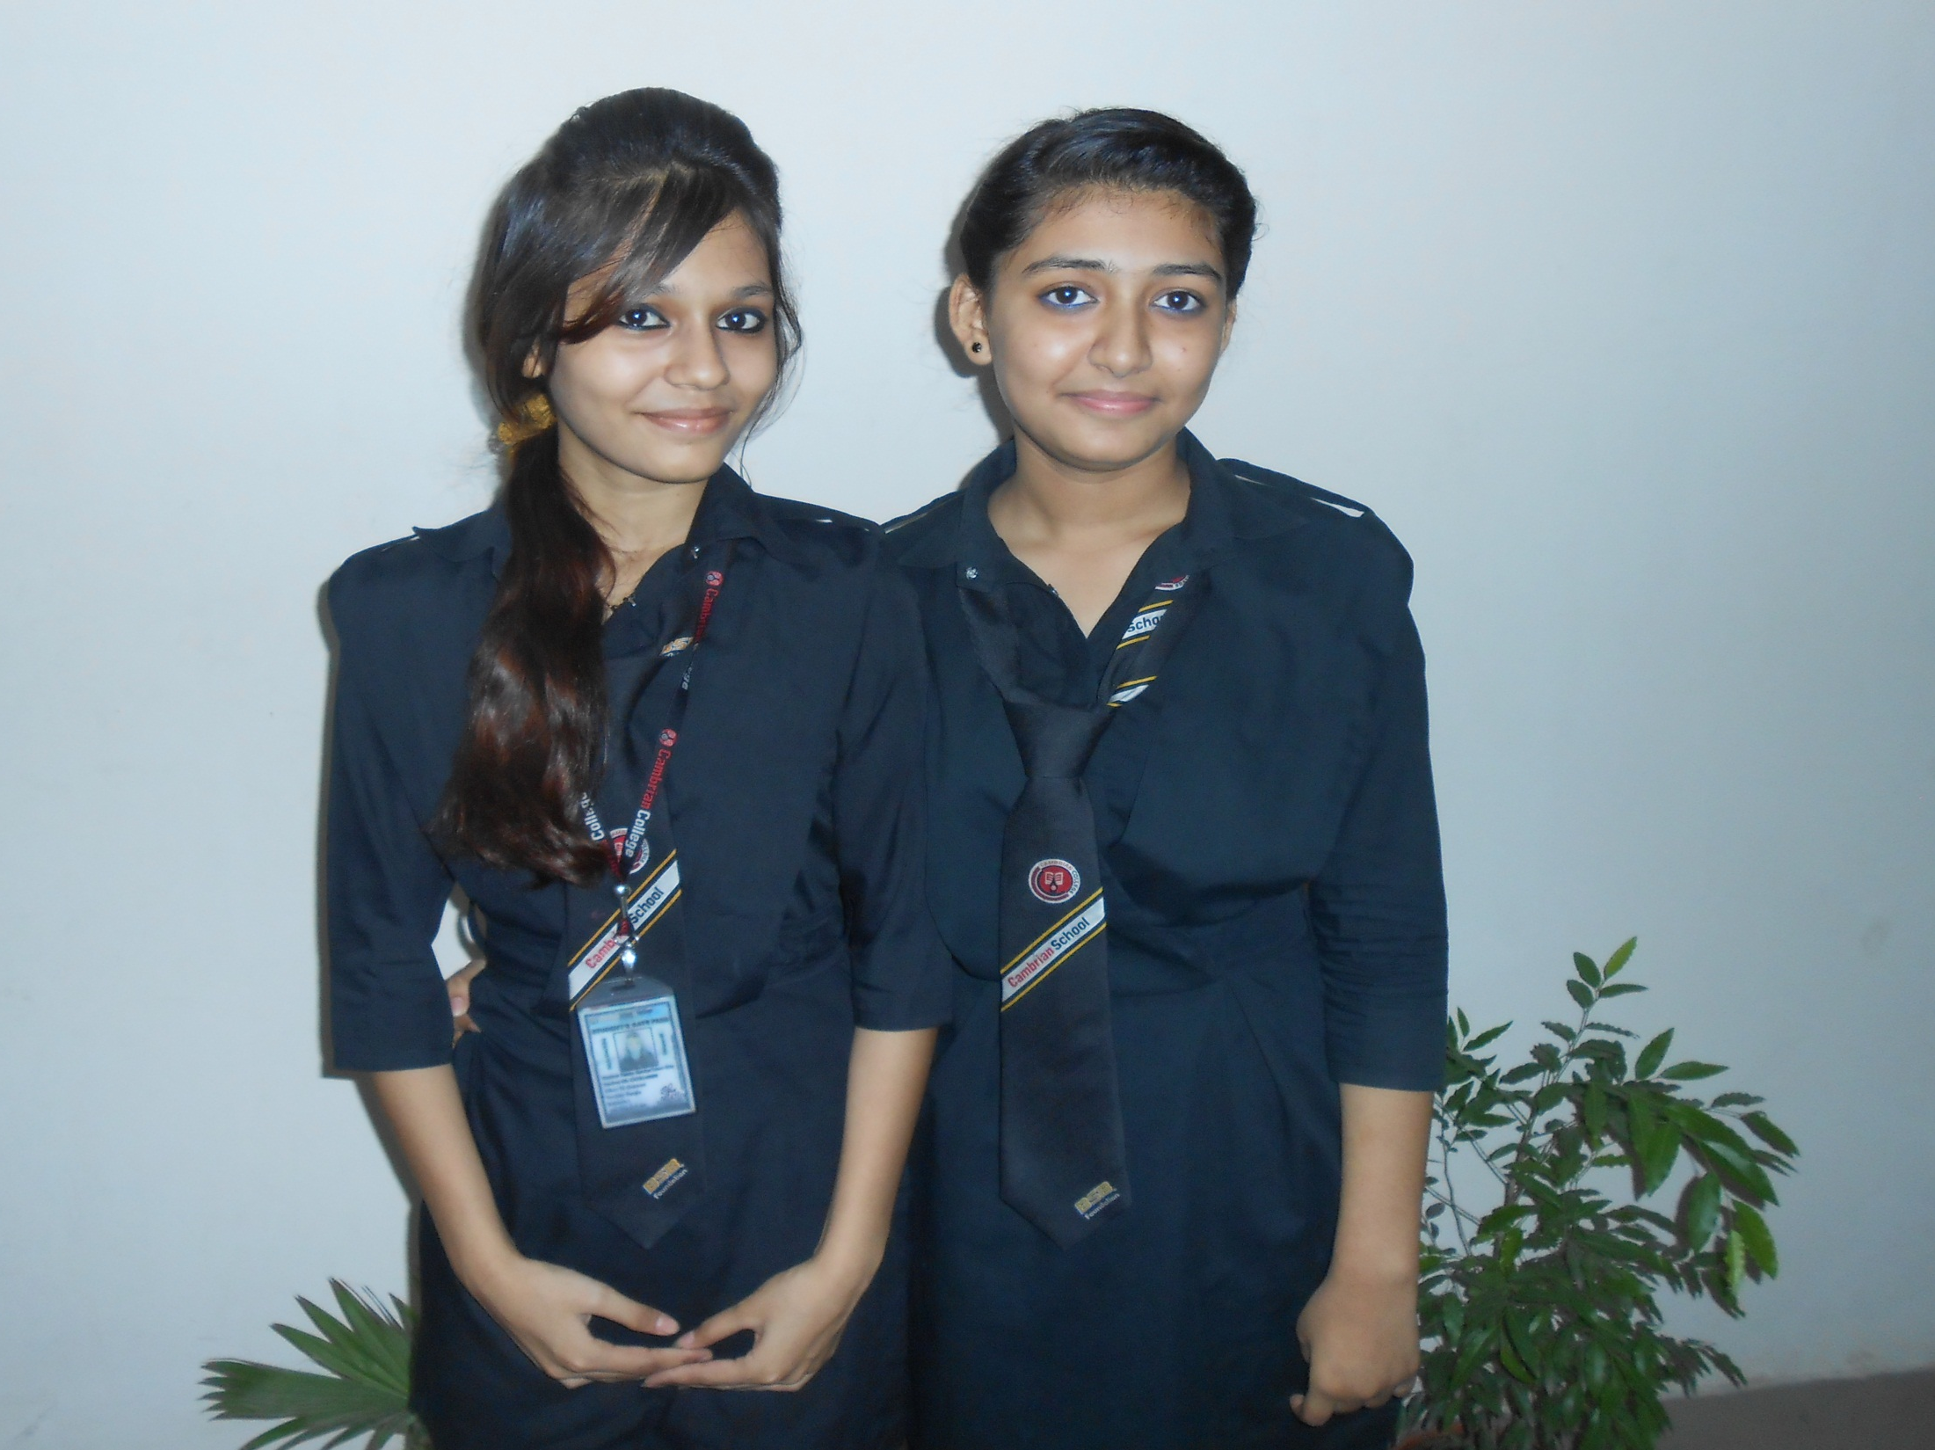
Oishi
Tisa

Slide 7
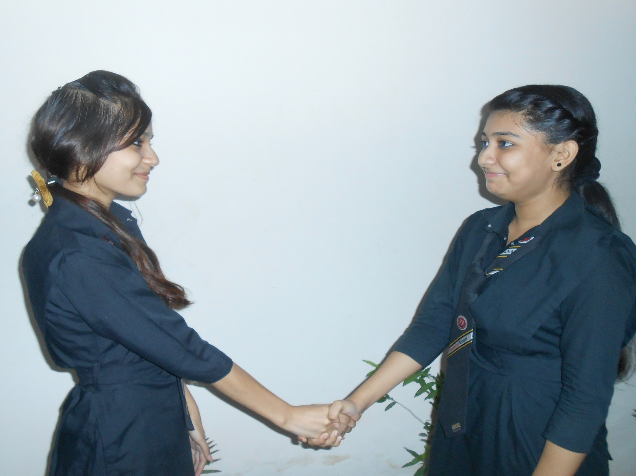
Assalamu Alaikum.
Walaikum Assalam.

Slide 8
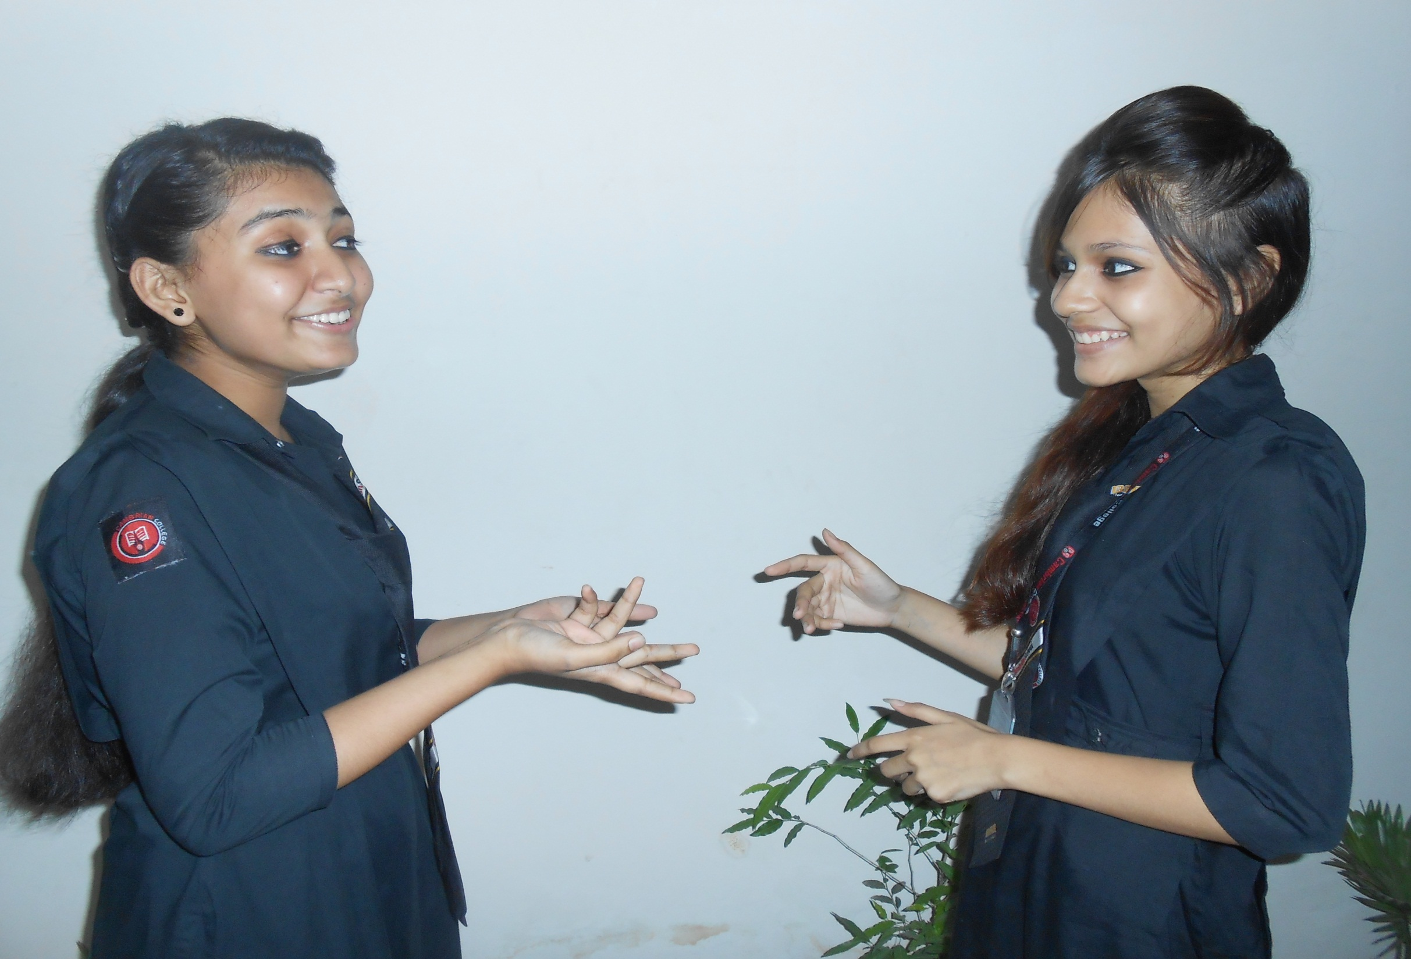
How are you my friend?
Alhamdulillah. But you?

Slide 9
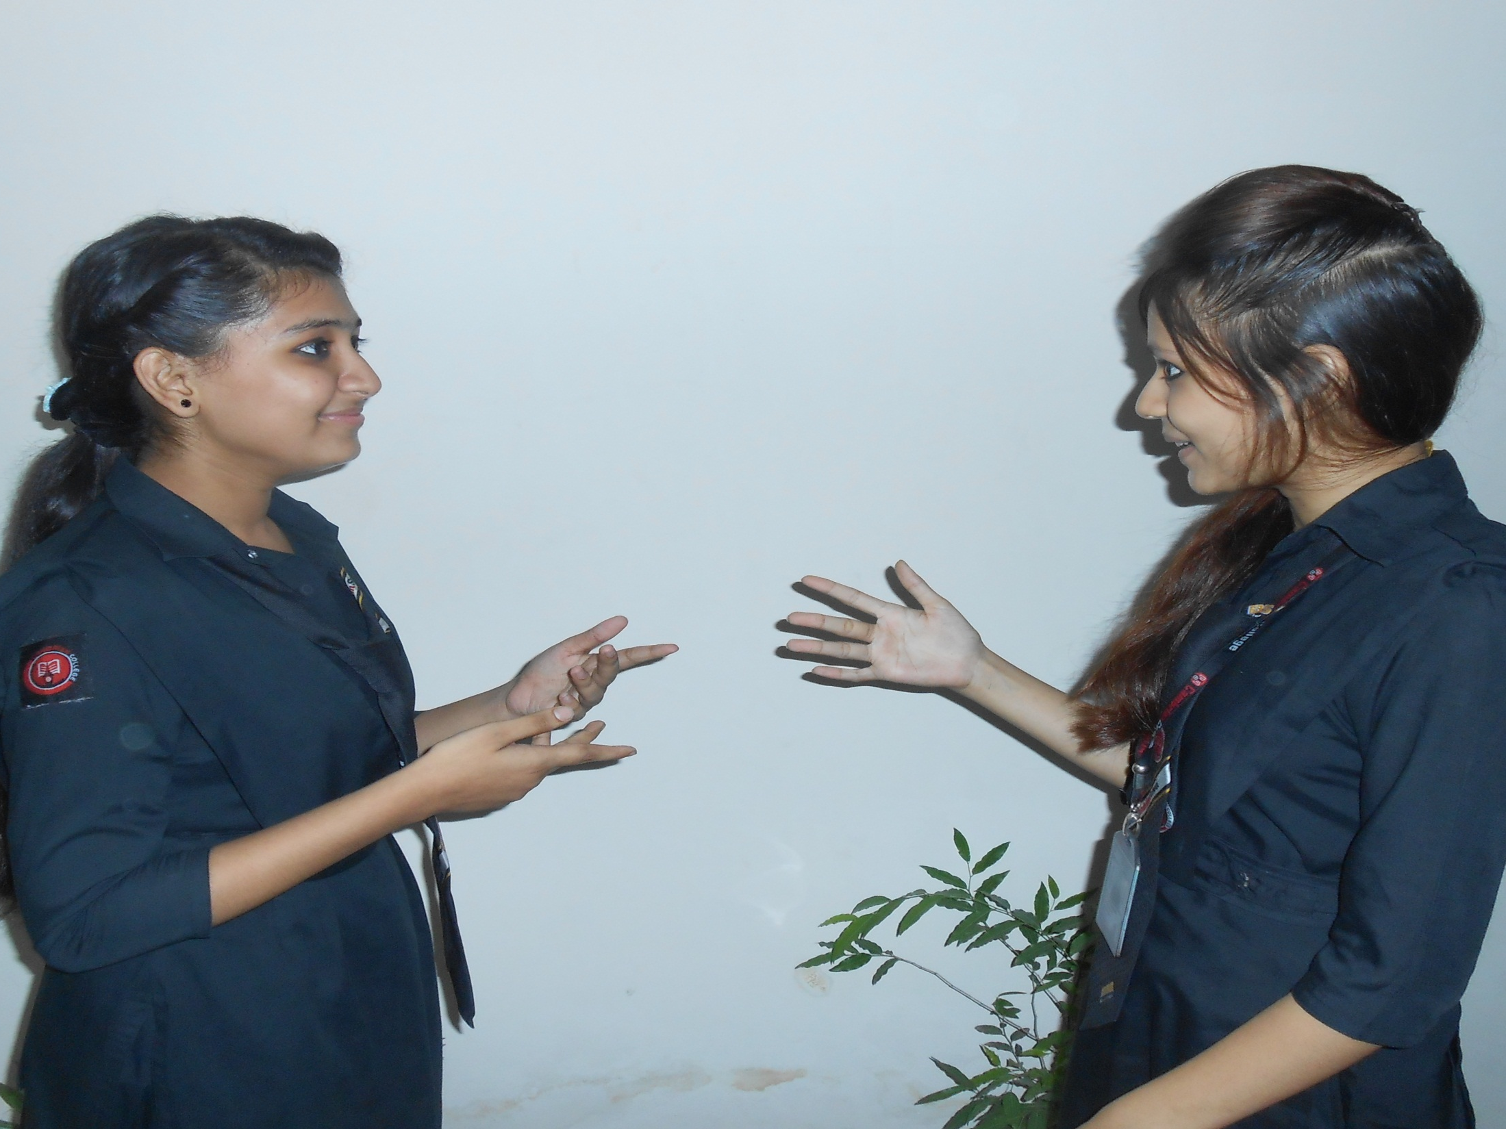
Masallah. I am also well by the grace of Allah.
Where did you go yesterday?

Slide 10
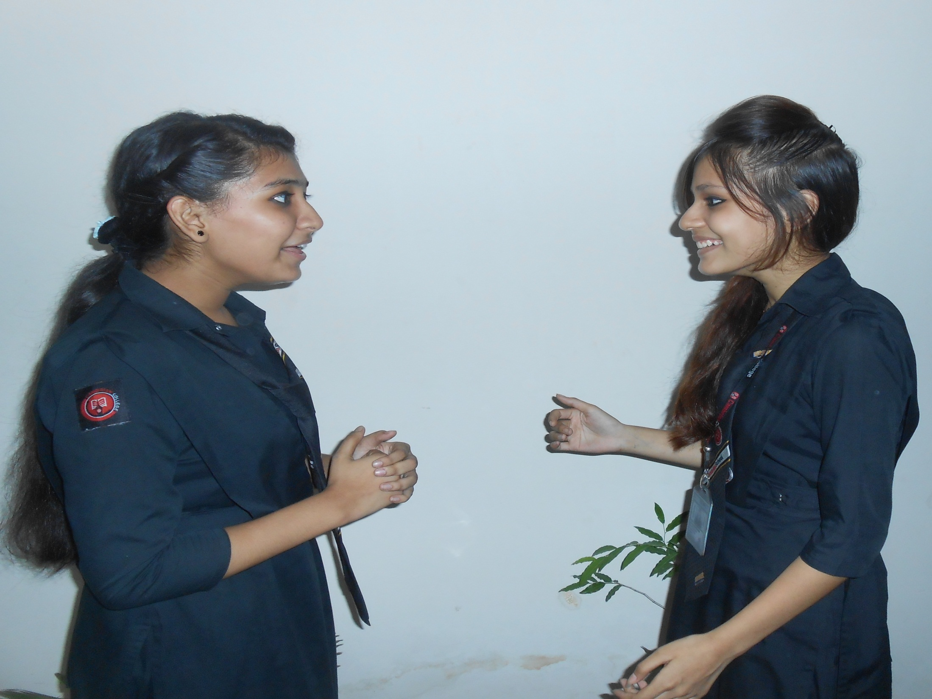
But why? Did you come to me?
Yes, but I did not find you.

Slide 11

O I see. Actually I went to visit a book fair yesterday.
How funny! But why did you not take me with you?

Slide 12
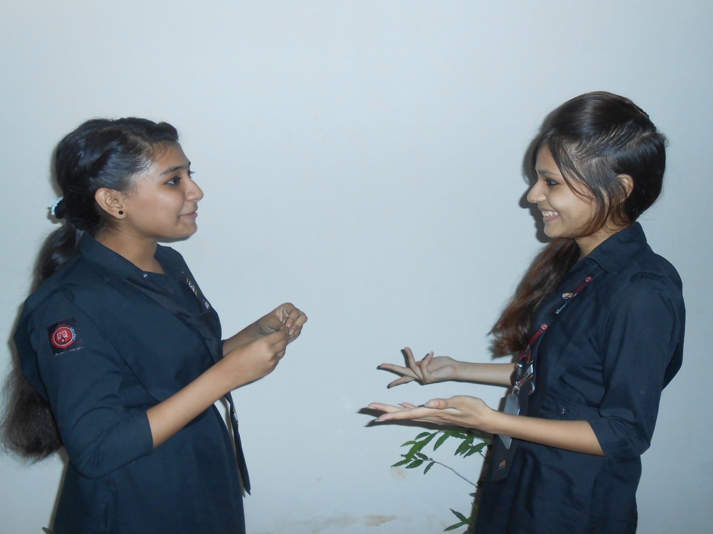
Sorry. I forgot to inform you.
Ok. How did you enjoy it?

Slide 13

I enjoyed it very much.
When did you go there?

Slide 14

I went there at 3 pm.
Who accompanied you?

Slide 15
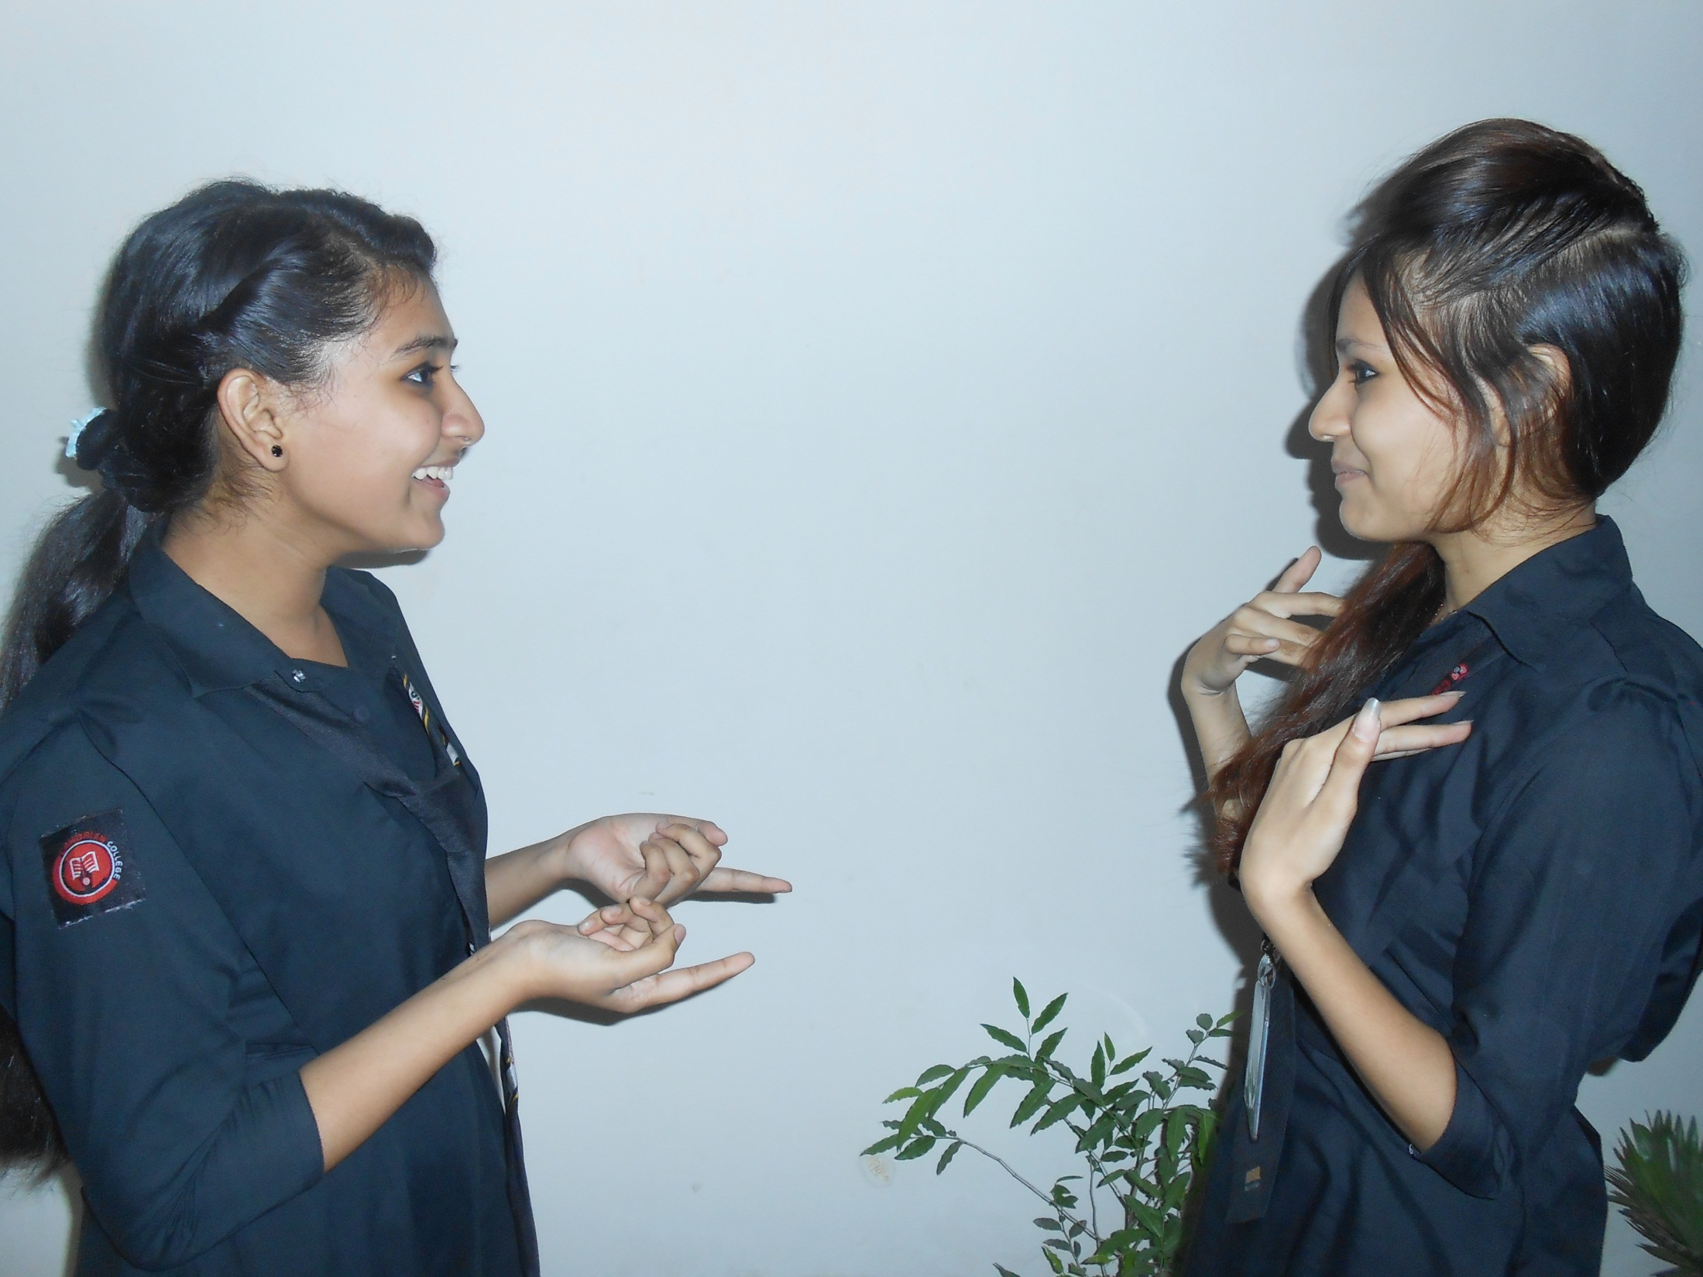
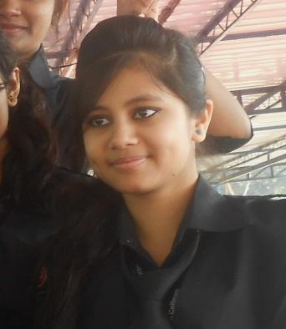
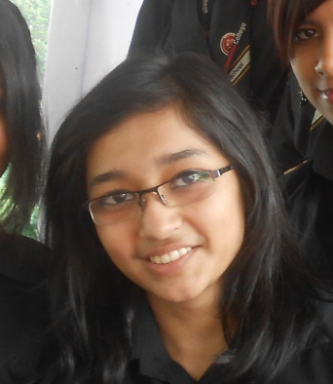
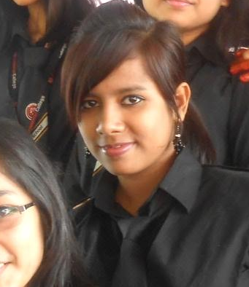
Mumu Jinia Rusha
Which book fair did you visit?

Slide 16

Bangla Academy.
Bangla Academy? Isn’t it the biggest book fair in Bangladesh?

Slide 17
Yes, you are right.
How was it decorated?

Slide 18
It was decorated gorgeously.
What do you mean?

Slide 19
There was a big gate to enter into the fair which was decorated with colourful paintings and artistic design.
What were there inside the fair?

Slide 20
Oh, there were hundreds of book stalls stood in two rows in the fair.
What were there in the book stalls?

Slide 21
Text books, story books, drama, children books, books on history, jokes, novels and what not?
Did you buy any book?

Slide 22
Sure, I bought as many as ten books.
Would you please tell me the books you bought?

Slide 23
The books were religious, novels, jokes and poems.
What did you enjoy there more?

Slide 24
I enjoyed a cultural program there participated by Imdadul Haque Milan, education Minister and so on.
What is your thinking about a book fair?

Slide 25
I think it beneficial for the people. Actually it is the store house of knowledge.
You are right. We all should visit the book fair every year.

Slide 26
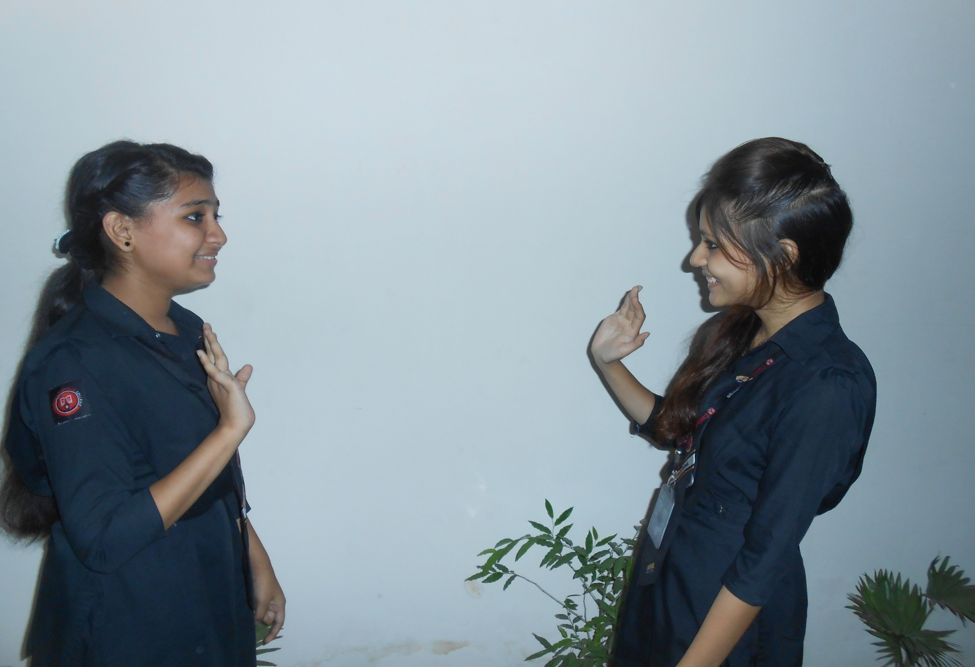
Thank you my friend.
Thank you also.

Slide 27
Pair Work
Every single pair is suggested
to write a dialogue on,
“ Visiting a book fair.”

Slide 28
Evaluation
Answer the following questions-
What is a book fair?
When does it take place?
Where did you pay a visit?
What did you see in the book fair?
What items of book did you buy from the book fair?

Slide 29
Homework
Write a dialogue with your friend about
“Visiting a book fair”

Slide 30
Verse Universal
“A book fair is a store house of knowledge”

Slide 31
Fi-Amanillah

